Slide 1
Pyshark – Lecture 2

Slide 2
Until now we have seen different tools provided by Wireshark, but at the same time we lose some degree of freedom.
Our idea is to investigate an alternative methodology to work with the same type of data but reaching similar results, and at the end build our own challenge.

Slide 3


“ Hello Pyshark”
Pyshark is a Python wrapper for tshark, allowing python packet parsing using wireshark dissectors.
This package allows parsing from a capture file or a live capture, using all wireshark dissectors you have installed. Tested on windows/linux.
*Reference : http://kiminewt.github.io/pyshark/

Slide 4

Installation
Follow this GitHub to install Pyshark: https://github.com/KimiNewt/pyshark/
Now we’ll go on using the programming language Python 3.
If you want to go deeper studying a valid alternative to pyshark it is suggested to see Scapy (https://scapy.readthedocs.io/en/latest/)

Slide 5
Let’s start from .pcap file
We can retrieve the pcap file saved from the last session with Wireshark and try to read our trace through Python.
*ReadPcap File
Capinfo different options
Editcap different options

Slide 6
Capinfo
Capinfos is a program that reads one or more capture files and returns some or all available statistics (infos) in one of two types of output formats: long or table.
Reference: https://www.wireshark.org/docs/man-pages/capinfos.html

Slide 7
Editcap
Editcap is a program that reads some or all of the captured packets from the infile, optionally converts them in various ways and writes the resulting packets to the capture outfile (or outfiles).
Reference: https://www.wireshark.org/docs/man-pages/editcap.html

Slide 8
Coding Part
The first coding part will show you how to extract all infos from a pcap file and split it according to time or number of packets.
Code Link : https://github.com/davaureli/NBD_LabSession
Lecture Folder: Lecture 2/Sequential/readPCAP.py

Slide 9
Extraction Field
In this coding part we will use for the first time “pyshark”, and it provides the possibility to gather info from the Ip and transport layer.
Code Link : https://github.com/davaureli/NBD_LabSession
Lecture Folder: Lecture 2/Sequential/readpcap_wireshark.py
This link provides the complete code so both for the field extraction and for the statistical analysis.

Slide 10
Statistical Analysis
Creating Dataframe
IP analysis (top sender and receiver)
BitRate different sampling metrics
GeoLocal referenciation for IP addresses
Analysis flows based

Slide 11
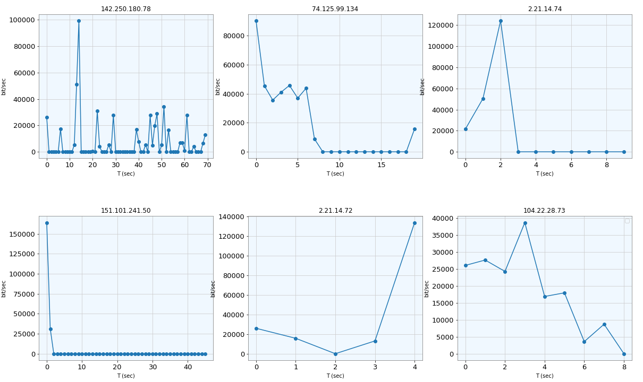
Top Receiver from My IP 192.168.43.28

Slide 12
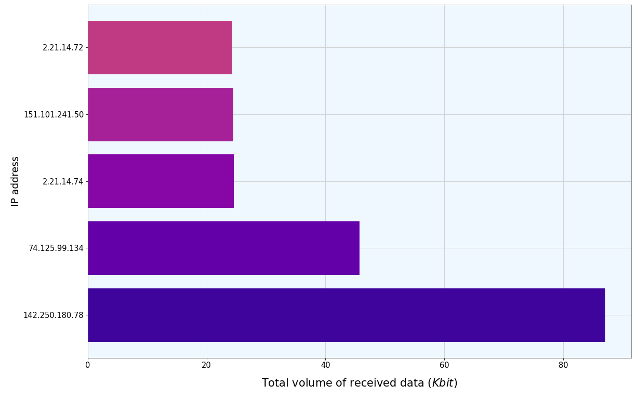
Top 5 Destination for Received Data (excluding My IP)

Slide 13
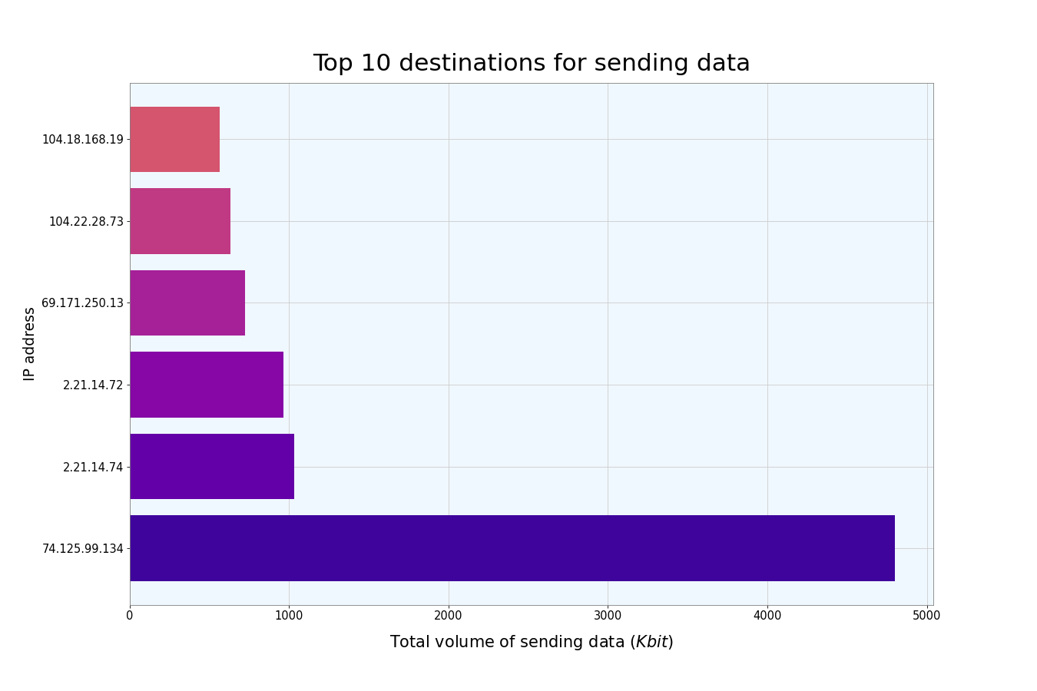
Top 6 Sender IP Addresses

Slide 14
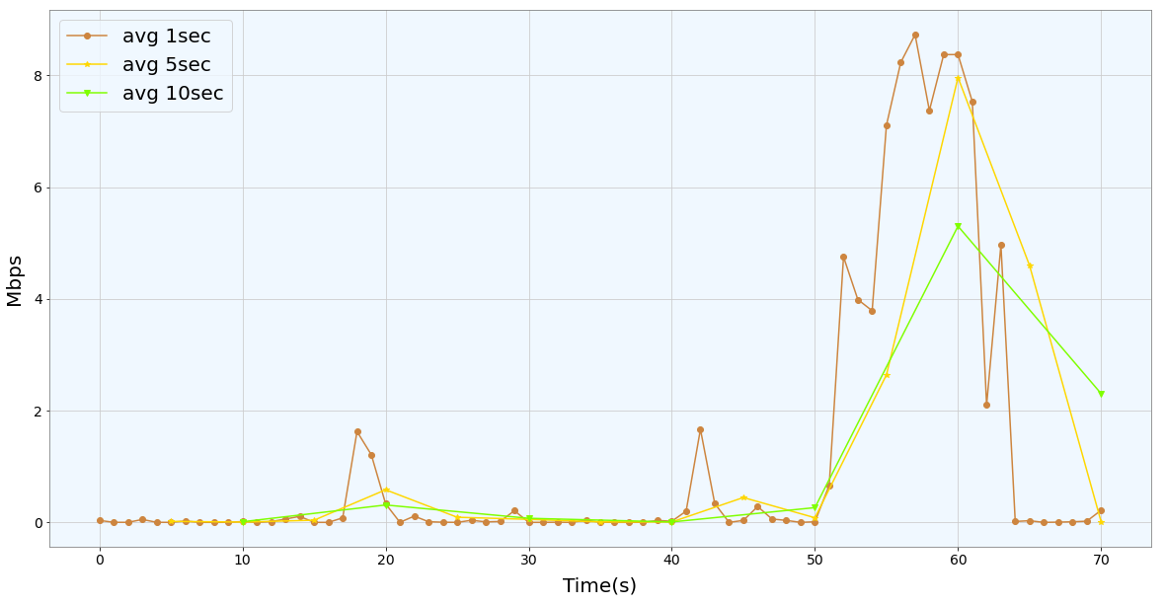
Different sampling BitRate

Slide 15
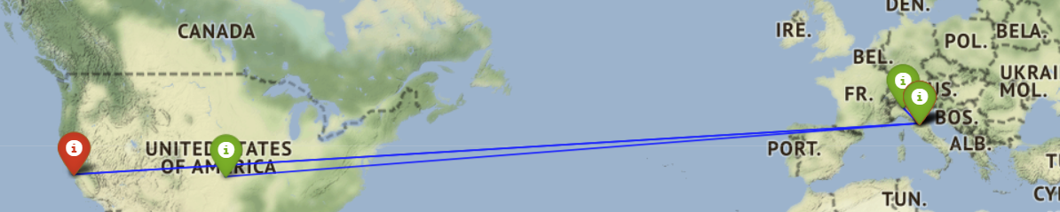
GeoLocal Referenciation
We can use ip2geotools and folium combining their properties to plot the positioning according to Latitude and Longitude of a specific IP src (i-green) and IP dst (i-red)

Slide 16
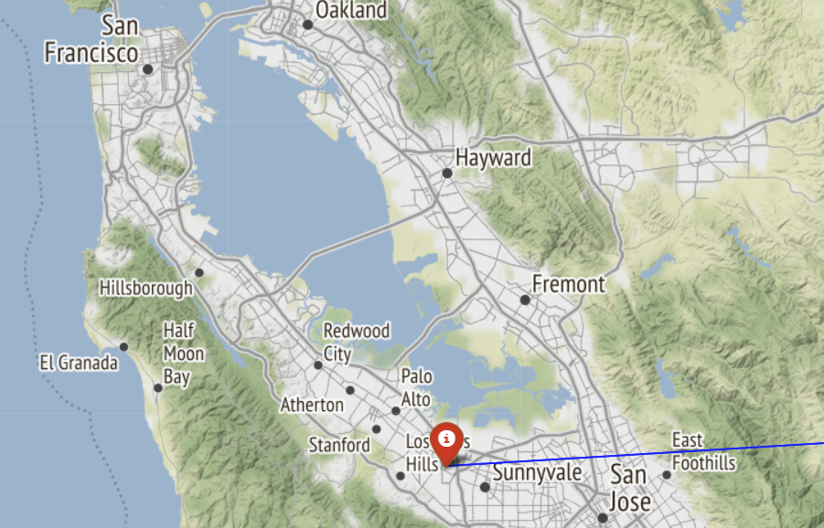
GeoLocal Referenciation

Slide 17
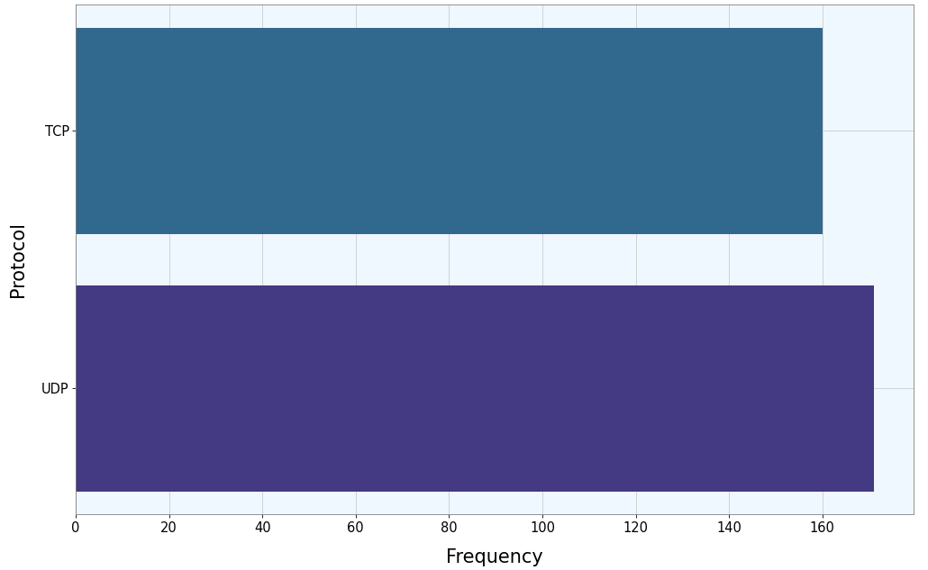
Protocol analysis based on flows

Slide 18
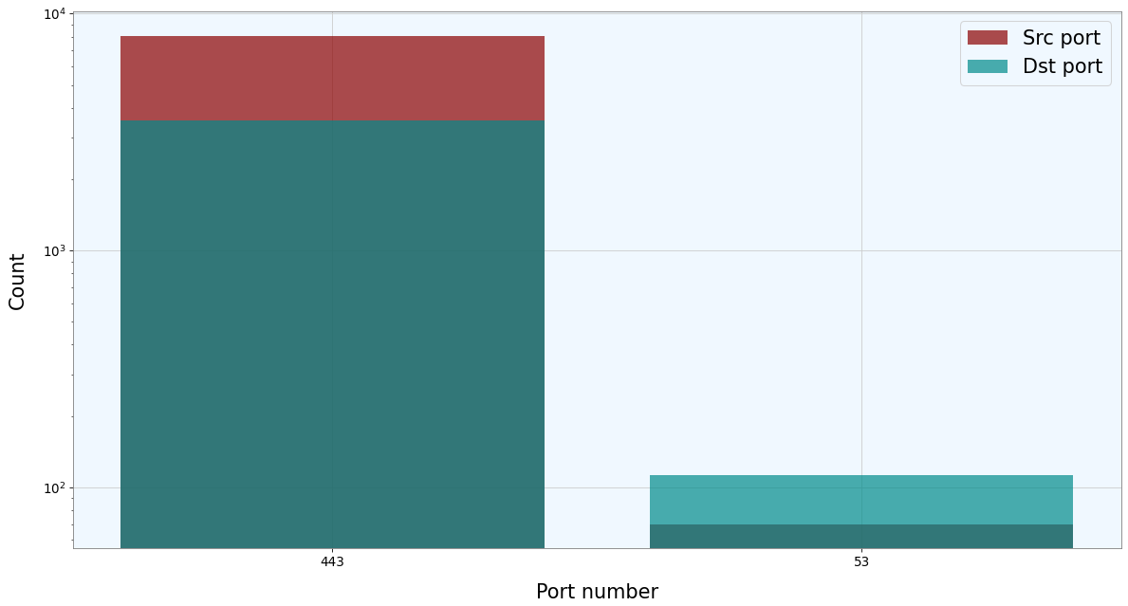
Port Scanner (just Well-Known Ports)

Slide 19
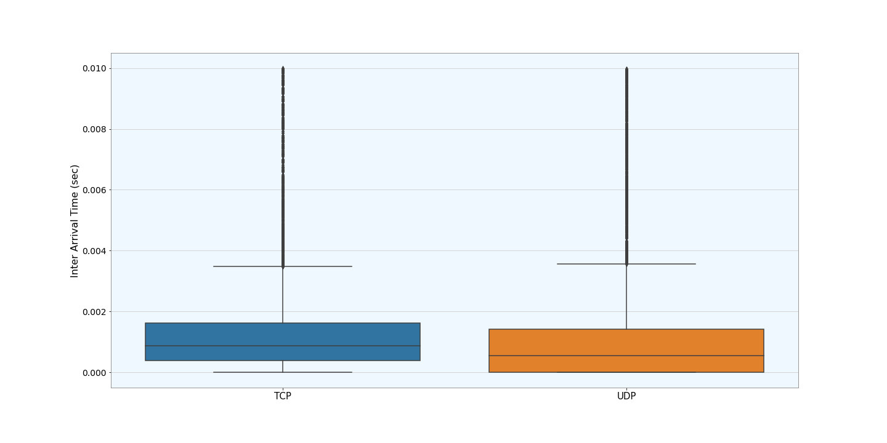
Interarrival Time difference between TCP and UDP

